Slide 1
K8s
Structure

Slide 2
Agenda
What is k8s
What is inside
How it works
Deployment
Minikube
K8s

Slide 3
K8s. What is k8s
Kubernetes (k8s) is an open-source system for automating deployment, scaling, and management of containerized applications.
It groups containers that make up an application into logical units for easy management and discovery.

Slide 4
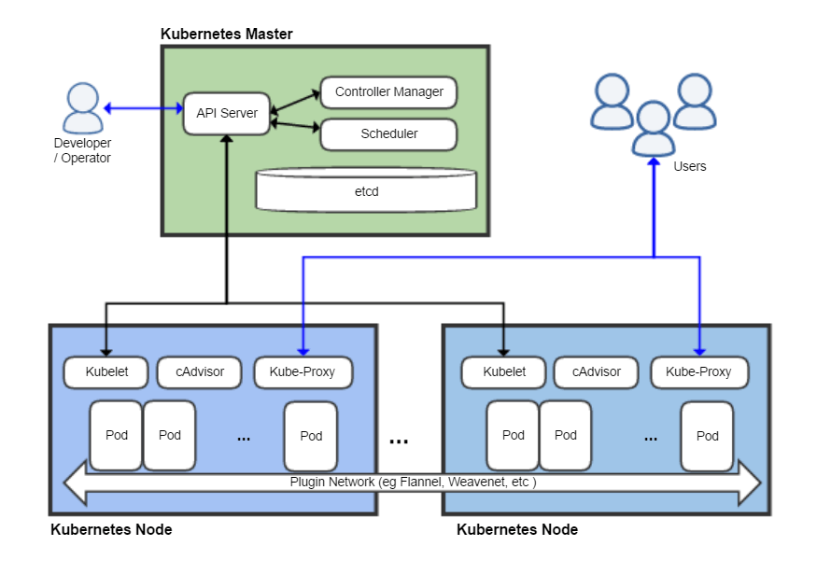
K8s. Architecture

Slide 5
K8s. Master Node
Tasks
managing the Kubernetes cluster
entry point for all administrative tasks
Inside
API Server
Scheduler
Controller Manager
etcd (can be separated host)

Slide 6
K8s. etcd
distributed key-value store
written in the Go
stores:
cluster state
subnets,
ConfigMaps,
Secrets,
etc

Slide 7
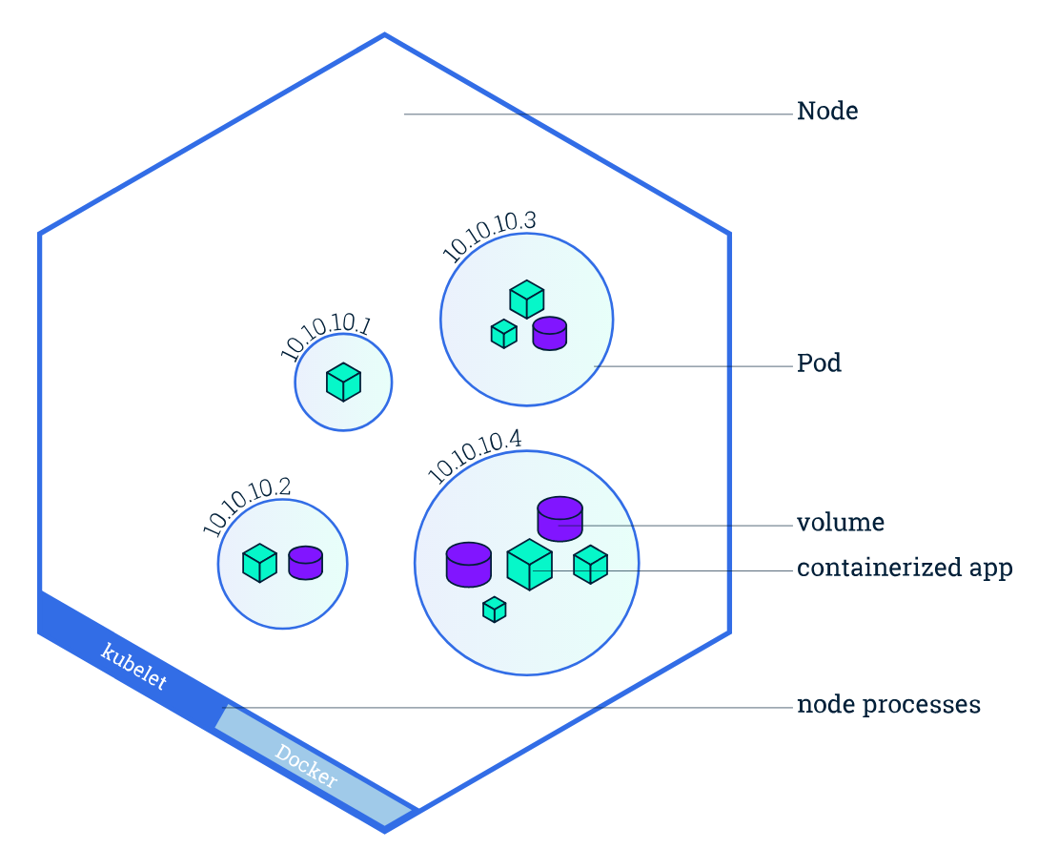
K8s. Worker Node
What is worker
machine (VM, physical server, etc.)
runs the applications using Pods and is controlled by the master node
container runtime
kubelet
kube-proxy

Slide 8
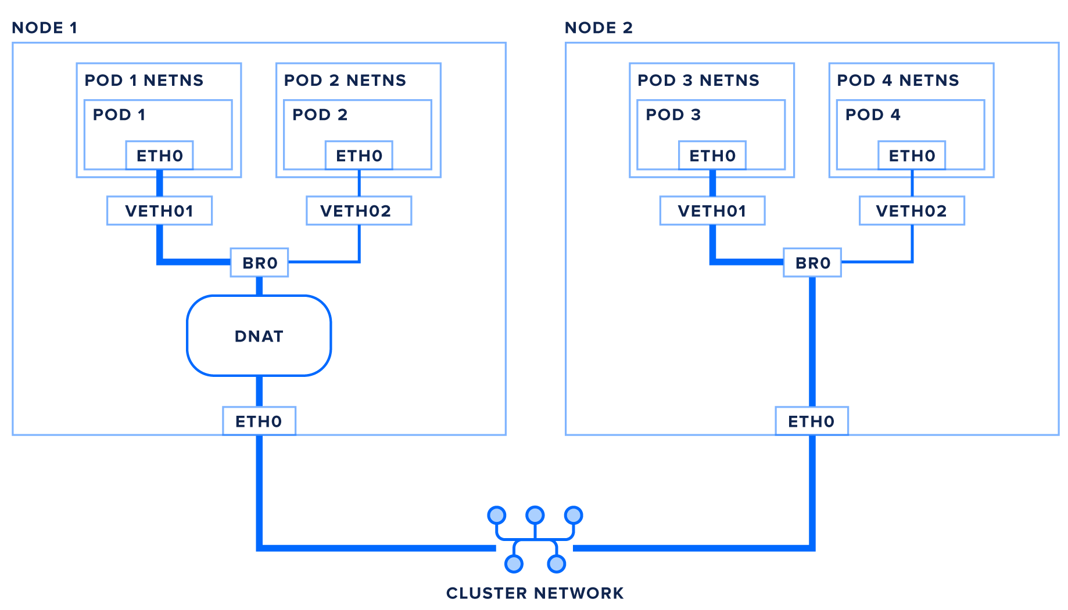
K8s. Network
Container-to-Container
Nodes-to-Containers
Pods with unique IPs
Pod-to-External

Slide 9
K8s. Network. Pod-to-Pod
No NAT
AWS VPC CNI
Google Compute Engine
...
Software Defined Networking
Flannel
Weave
Calico, etc.
* CNI (Container Network Interface)

Slide 10
K8s. Installing
Minikube
Simple for test
K3s (next lesson)
Full k8s
kubeadm
KubeSpray
Kops
From scratch

Slide 11
K8s. Installing. Minikube. Demo
Requirements
Install kubectl
Install minikube
Access to the API/Dashboard

Slide 12
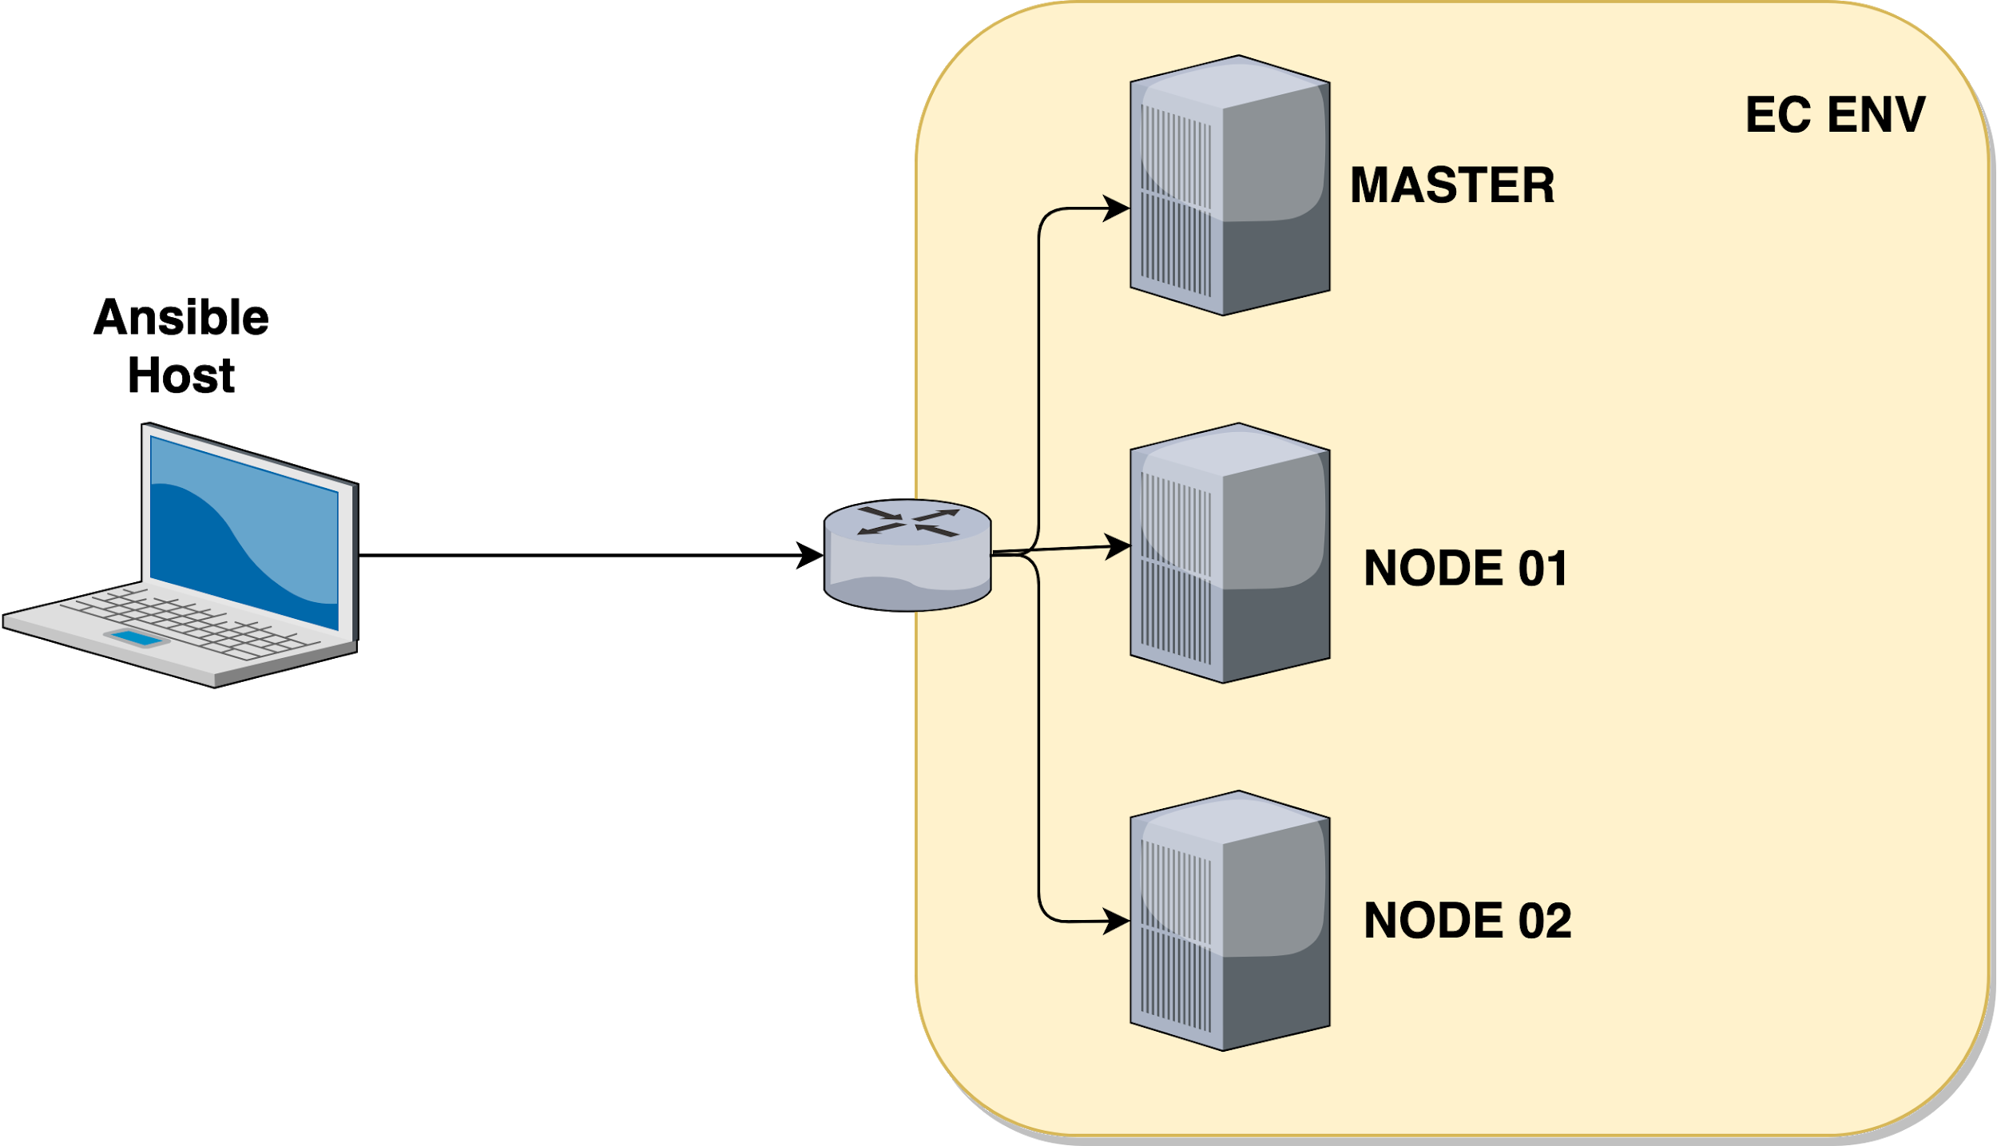
HLD

Slide 13
K8s. To read
https://kubernetes.io/docs/setup/minikube/#installation
https://kubernetes.io/docs/tutorials/
https://github.com/kubernetes-sigs/kubespray

